Slide 1
Statics of Particles

Slide 2
Contents
Introduction
Force on a Particle. Resultant of Two Forces
Vectors
Addition of Vectors
Resultant of Several Concurrent Forces
Sample Problem 2.1
Sample Problem 2.2
Rectangular Components of a Force: Unit Vectors
Addition of Forces by Summing Components
Sample Problem 2.3
Equilibrium of a Particle
Free-Body Diagrams
Sample Problem 2.4
Sample Problem 2.6
Rectangular Components of a Force in Space
Sample Problem 2.7
2 - <number>

Slide 3

Application
The tension in the cable supporting this person can be found using the concepts in this chapter
2 - <number>

Slide 4
Introduction
The objective for the current chapter is to investigate the effects of forces on particles:
- replacing multiple forces acting on a particle with a single equivalent or resultant force,
- relations between forces acting on a particle that is in a state of equilibrium.
The focus on particles does not imply a restriction to miniscule bodies. Rather, the study is restricted to analyses in which the size and shape of the bodies is not significant so that all forces may be assumed to be applied at a single point.
2 - <number>

Slide 5
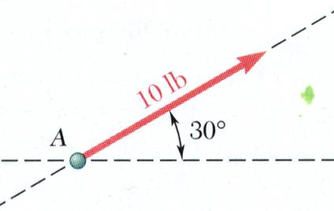
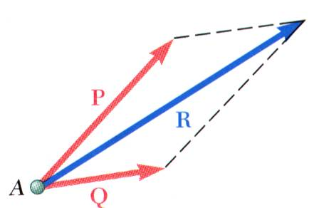
Force on a Particle. Resultant of Two Forces
Force: action of one body on another; characterized by its point of application, magnitude, line of action, and sense.
10 N
Experimental evidence shows that the combined effect of two forces may be represented by a single resultant force.
The resultant is equivalent to the diagonal of a parallelogram which contains the two forces in adjacent legs.
Force is a vector quantity.
2 - <number>

Slide 6
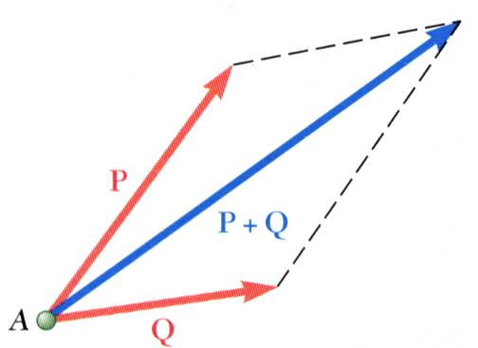
Vectors
Vector: Parameters possessing magnitude and direction which add according to the parallelogram law. Examples: displacements, velocities, accelerations.
Scalar: Parameters possessing magnitude but not direction. Examples: mass, volume, temperature
Vector classifications:
  Fixed or bound vectors have well defined points of application that cannot be changed without affecting
  an analysis.
  Free vectors may be freely moved in space without changing their effect on an analysis.
  Sliding vectors may be applied anywhere along their line of action without affecting an analysis.
2 - <number>

Slide 7
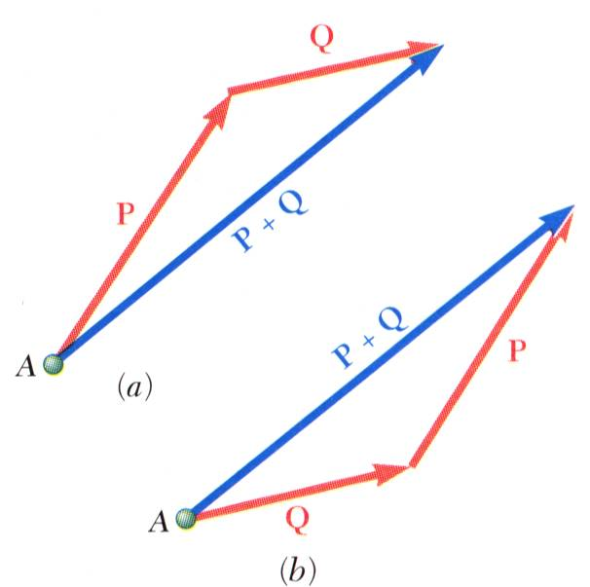
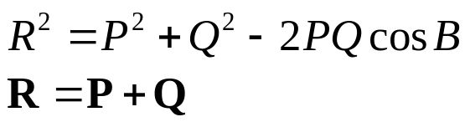
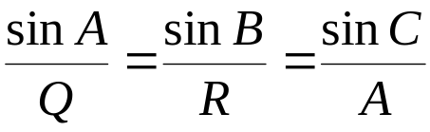
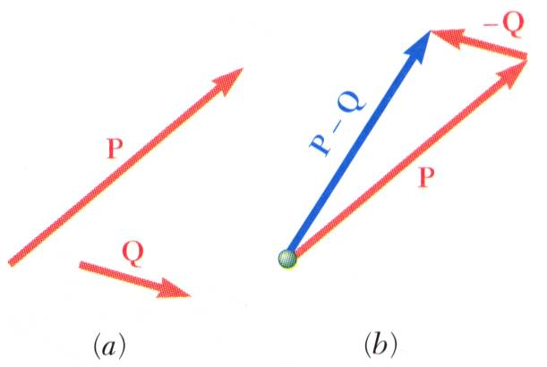


Addition of Vectors
Trapezoid rule for vector addition
Triangle rule for vector addition
Law of cosines,
C
B
C
Law of sines,
B
Vector addition is commutative,
Vector subtraction
2 - <number>

Slide 8
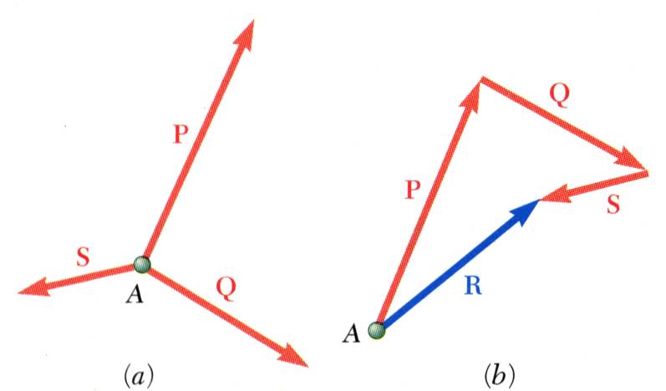
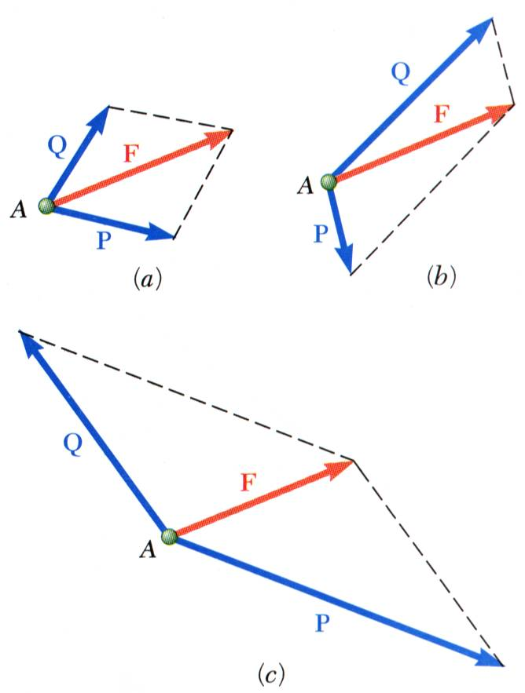
Resultant of Several Concurrent Forces
Concurrent forces: set of forces which all pass through the same point.
A set of concurrent forces applied to a particle may be replaced by a single resultant force which is the vector sum of the applied forces.
Vector force components: two or more force vectors which, together, have the same effect as a single force vector.
2 - <number>

Slide 9
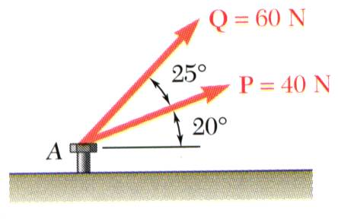
Sample Problem 2.1
SOLUTION:
Graphical solution - construct a parallelogram with sides in the same direction as P and Q and lengths in proportion. Graphically evaluate the resultant which is equivalent in direction and proportional in magnitude to the diagonal.
The two forces act on a bolt at A. Determine their resultant.
Trigonometric solution - use the triangle rule for vector addition in conjunction with the law of cosines and law of sines to find the resultant.
2 - <number>

Slide 10
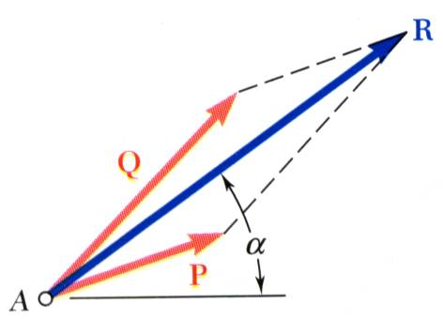

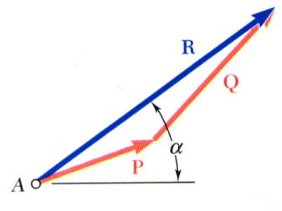
Sample Problem 2.1
Graphical solution - A parallelogram with sides equal to P and Q is drawn to scale. The magnitude and direction of the resultant or of the diagonal to the parallelogram are measured,
Graphical solution - A triangle is drawn with P and Q head-to-tail and to scale. The magnitude and direction of the resultant or of the third side of the triangle are measured,
2 - <number>

Slide 11
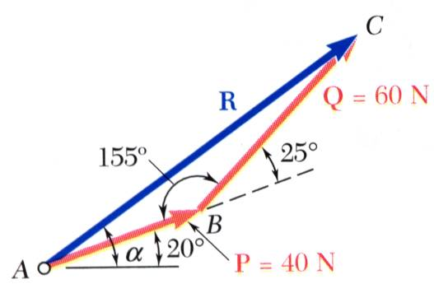
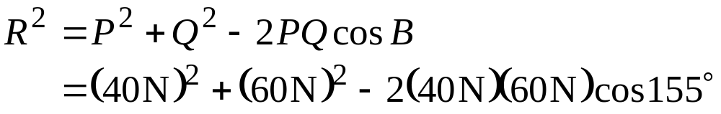

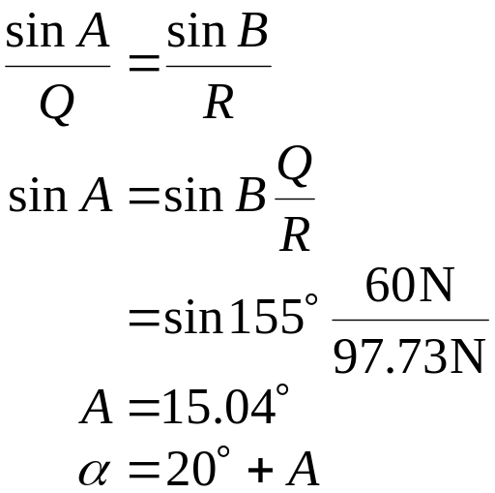

Sample Problem 2.1
Trigonometric solution - Apply the triangle rule.
From the Law of Cosines,
From the Law of Sines,
2 - <number>

Slide 12
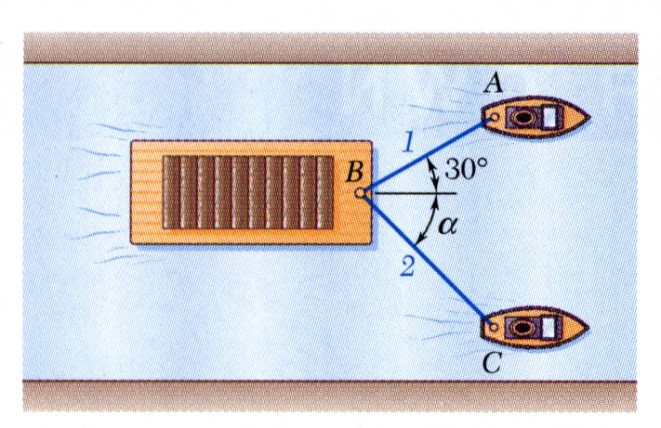
Sample Problem 2.2
SOLUTION:
Find a graphical solution by applying the Parallelogram Rule for vector addition. The parallelogram has sides in the directions of the two ropes and a diagonal in the direction of the barge axis and length proportional to 5 kN.
A barge is pulled by two tugboats. If the resultant of the forces exerted by the tugboats is a 5-kN force directed along the axis of the barge, determine the tension in each of the ropes for α = 45º.
Find a trigonometric solution by applying the Triangle Rule for vector addition. With the magnitude and direction of the resultant known and the directions of the other two sides parallel to the ropes given, apply the Law of Sines to find the rope tensions.
Discuss with a neighbor how you would solve this problem.
2 - <number>

Slide 13
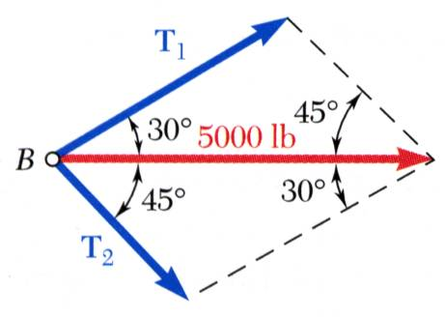

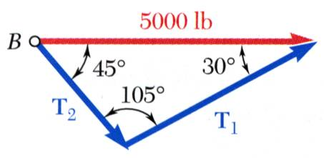
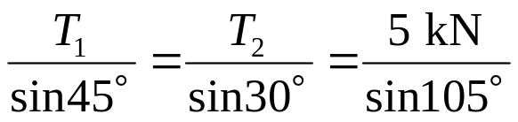

Sample Problem 2.2
Graphical solution - Parallelogram Rule with known resultant direction and magnitude, known directions for sides.
T₁ = 3.7 kN T₂ = 2.6 kN
5 kN
Trigonometric solution - Triangle Rule with Law of Sines
5 kN
T₁ = 3.66 kN T₂ = 2.59 kN
2 - <number>

Slide 14
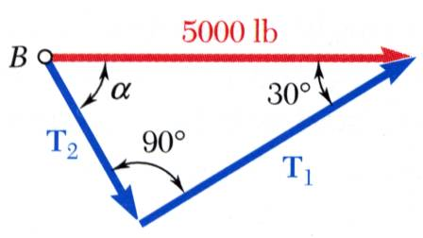






What if…?
At what value of α would the tension in rope 2 be a minimum?
Hint: Use the triangle rule and think about how changing α changes the magnitude of T₂. After considering this, discuss your ideas with a neighbor.
The minimum tension in rope 2 occurs when T₁ and T₂ are perpendicular.
5 kN
2 - <number>

Slide 15
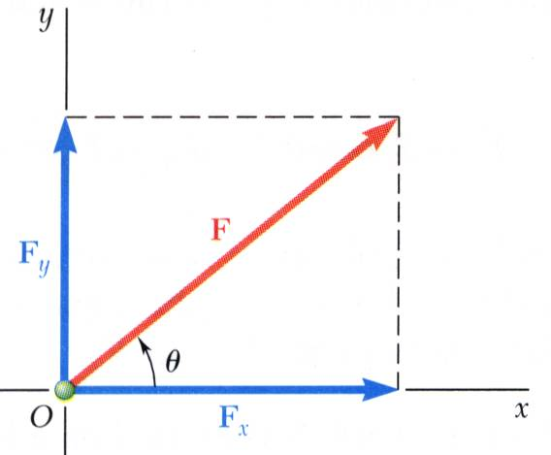
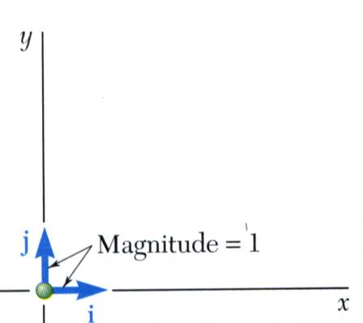
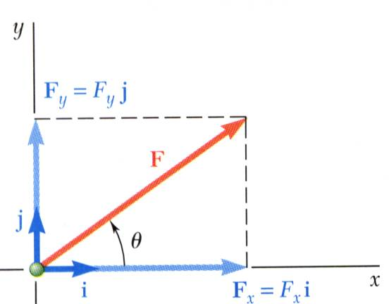
Rectangular Components of a Force: Unit Vectors
It is possible to resolve a force vector into perpendicular components so that the resulting parallelogram is a rectangle. F_{x} and F_{y} are referred to as rectangular vector components and
F = F_{x} + F_{y}
Define perpendicular unit vectors i and j which are parallel to the x and y axes.
Vector components may be expressed as products of the unit vectors with the scalar magnitudes of the vector components.
F = F_{x}i + F_{y}j
F_{x} and F_{y} are referred to as the scalar components of F.
2 - <number>

Slide 16
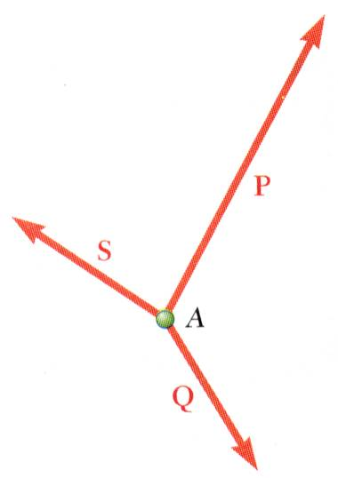
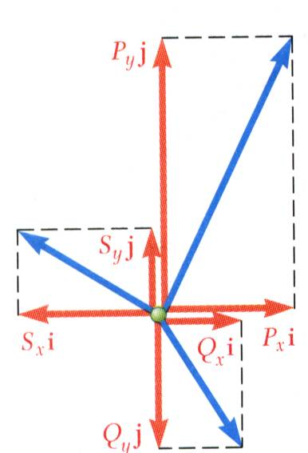
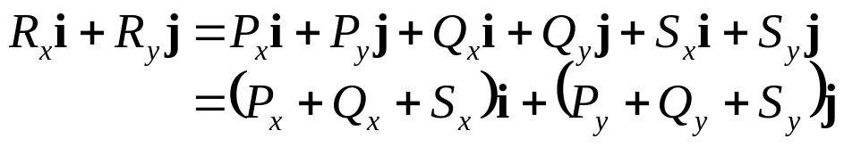
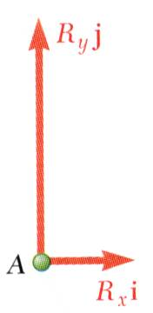
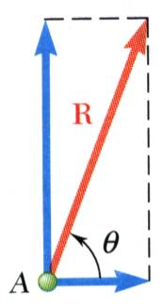
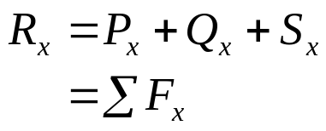
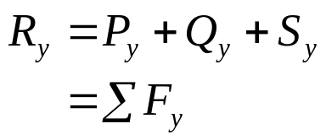
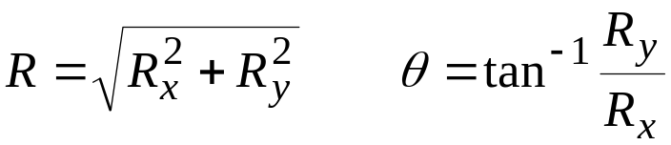
Addition of Forces by Summing Components
To find the resultant of 3 (or more) concurrent forces,
R = P + Q + S
Resolve each force into rectangular components, then add the components in each direction:
The scalar components of the resultant vector are equal to the sum of the corresponding scalar components of the given forces.
To find the resultant magnitude and direction,
2 - <number>

Slide 17
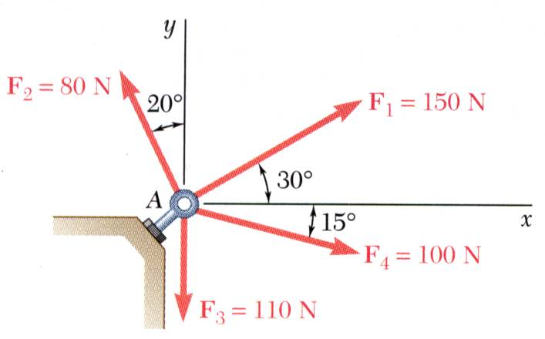
Sample Problem 2.3
SOLUTION:
Resolve each force into rectangular components.
Determine the components of the resultant by adding the corresponding force components in the x and y directions.
Four forces act on bolt A as shown. Determine the resultant of the forces on the bolt.
Calculate the magnitude and direction of the resultant.
2 - <number>

Slide 18
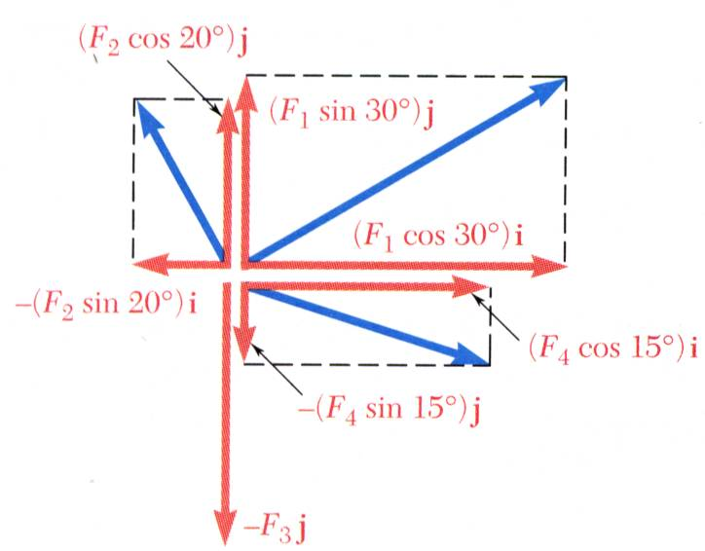
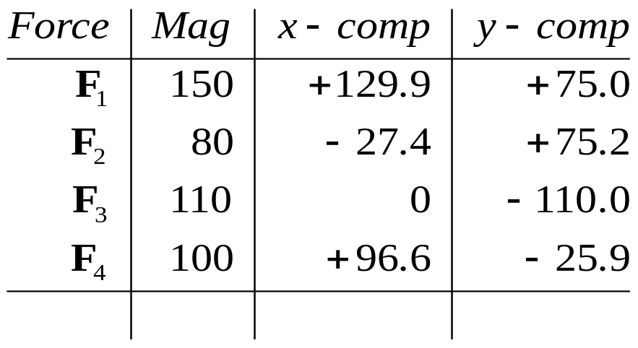


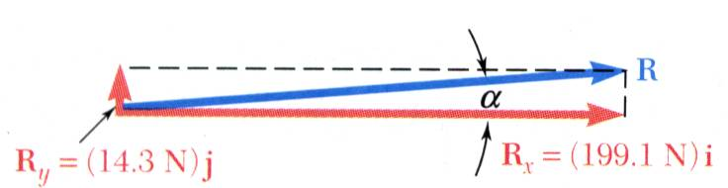
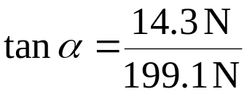

Sample Problem 2.3
SOLUTION:
Resolve each force into rectangular components.
Determine the components of the resultant by adding the corresponding force components.
Calculate the magnitude and direction.
2 - <number>

Slide 19
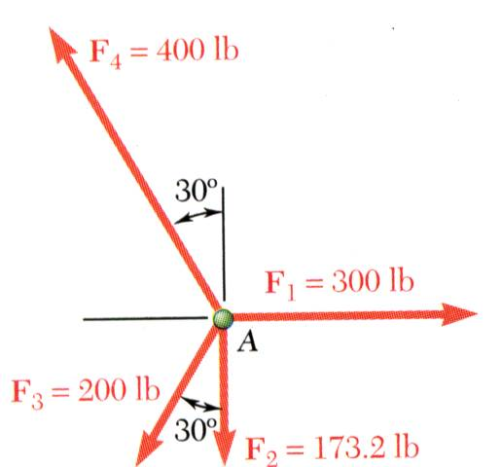
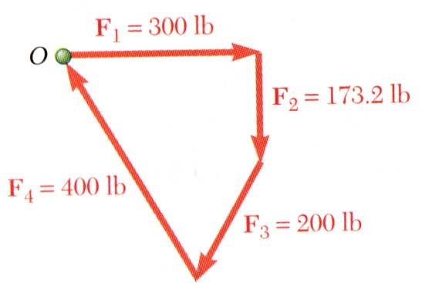
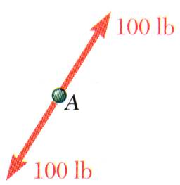
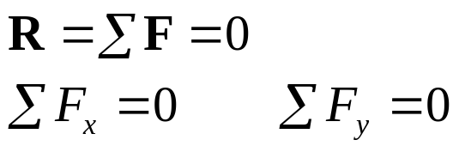
Equilibrium of a Particle
When the resultant of all forces acting on a particle is zero, the particle is in equilibrium.
Newton’s First Law: If the resultant force on a particle is zero, the particle will remain at rest or will continue at constant speed in a straight line.
F₄ = 400 N
F₁ = 300 N
100 N
F₂ = 173.2 N
F₁ = 300 N
F₄ = 400 N
F₃ = 200 N
F₃ = 200 N
100 N
F₂ = 173.2 N
Particle acted upon by two forces:
  equal magnitude
  same line of action
  opposite sense
Particle acted upon by three or more forces:
  graphical solution yields a closed polygon
  algebraic solution
2 - <number>

Slide 20
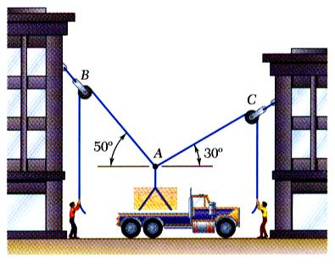
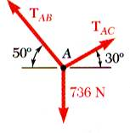
Free-Body Diagrams
Space Diagram: A sketch showing the physical conditions of the problem, usually provided with the problem statement, or represented by the actual physical situation.
Free Body Diagram: A sketch showing only the forces on the selected particle. This must be created by you.
2 - <number>

Slide 21
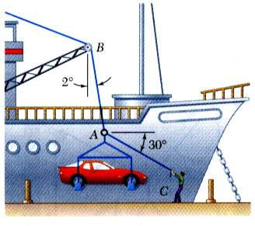
Sample Problem 2.4
SOLUTION:
Construct a free body diagram for the particle at the junction of the rope and cable.
Apply the conditions for equilibrium by creating a closed polygon from the forces applied to the particle.
Apply trigonometric relations to determine the unknown force magnitudes.
In a ship-unloading operation, a 3500-N automobile is supported by a cable. A rope is tied to the cable and pulled to center the automobile over its intended position. What is the tension in the rope?
2 - <number>

Slide 22
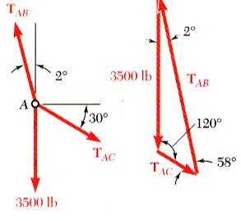
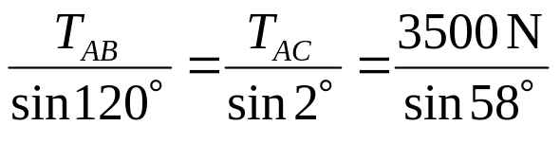


Sample Problem 2.4
SOLUTION:
Construct a free body diagram for the particle at A, and the associated polygon.
Apply the conditions for equilibrium and solve for the unknown force magnitudes.
Law of Sines:
3500 N
3500 N
2 - <number>

Slide 23
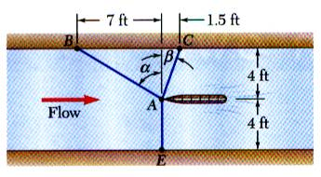
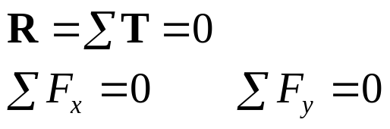
Sample Problem 2.6
7 m
1.5 m
SOLUTION:
Decide what the appropriate “body” is and draw a free body diagram
4 m
4 m
The condition for equilibrium states that the sum of forces equals 0, or:
It is desired to determine the drag force at a given speed on a prototype sailboat hull. A model is placed in a test channel and three cables are used to align its bow on the channel centerline. For a given speed, the tension is 200 N in cable AB and 300 N in cable AE.
Determine the drag force exerted on the hull and the tension in cable AC.
The two equations mean we can solve for, at most, two unknowns. Since there are 4 forces involved (tensions in 3 cables and the drag force), it is easier to resolve all forces into components and apply the equilibrium conditions
2 - <number>

Slide 24
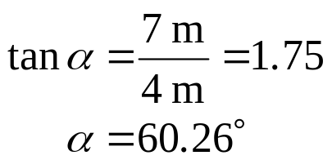
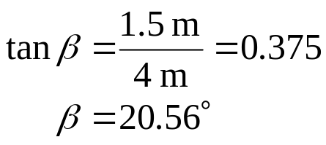
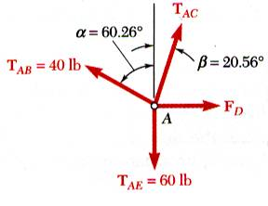

Sample Problem 2.6
7 m
1.5 m
SOLUTION:
The correct free body diagram is shown and the unknown angles are:
4 m
4 m
T_{AB} = 200 N
Equilibrium condition requires that the resultant force (or the sum of all forces) be zero:
T_{AE} = 300 N
Write each force vector above in component form.
2 - <number>

Slide 25


Sample Problem 2.6
Resolve the three forces into two component equations.
(200 N) cos 60.26º j
−(200 N) cos 60.26º i
− (300 N) j
2 - <number>

Slide 26


Sample Problem 2.6
Factor unit vectors:
This equation is satisfied only if each component of the resultant is equal to zero
F_{D} = 98.35 N
T_{AC} = 214.45 N
T_{AE} = 300 N
T_{AB} = 200 N
2 - <number>

Slide 27






Rectangular Components of a Force in Space
If angles with some of the axes are given:
The vector F is contained in the plane OBAC.
Resolve F into horizontal and vertical components.
Resolve F_{h} into rectangular components
2 - <number>

Slide 28






Rectangular Components of a Force in Space
If the direction cosines are given:
With the angles between F and the axes,
λ is a unit vector along the line of action of F
and are the direction cosines for F.
2 - <number>

Slide 29



Rectangular Components of a Force in Space
If two points on the line of action are given:
Direction of the force is defined by the location of two points,
2 - <number>

Slide 30

Sample Problem 2.7
SOLUTION:
Based on the relative locations of the points A and B, determine the unit vector pointing from A towards B.
Apply the unit vector to determine the components of the force acting on A.
Noting that the components of the unit vector are the direction cosines for the vector, calculate the corresponding angles.
The tension in the guy wire is 2500 N. Determine:
a) components F_{x}, F_{y}, F_{z} of the force acting on the bolt at A,
b) the angles θ_{x}, θ_{y}, θ_{z} defining the direction of the force (the direction cosines)
2 - <number>

Slide 31




Sample Problem 2.7
SOLUTION:
Determine the unit vector pointing from A towards B.
Determine the components of the force.
2 - <number>

Slide 32



Sample Problem 2.7
Noting that the components of the unit vector are the direction cosines for the vector, calculate the corresponding angles.
2 - <number>

Slide 33

What if…?
SOLUTION:
Since the force in the guy wire must be the same throughout its length, the force at B (and acting toward A) must be the same magnitude but opposite in direction to the force at A.
F_{BA}
F_{AB}
What are the components of the force in the wire at point B? Can you find it without doing any calculations?
Give this some thought and discuss this with a neighbor.
2 - <number>

